Slide 1

Advanced Early Dengue Prediction and Exploration Service
Dominic Ligot, Claire Tayco, Mark Toledo, Jansen Lopez
October 2019

Slide 2

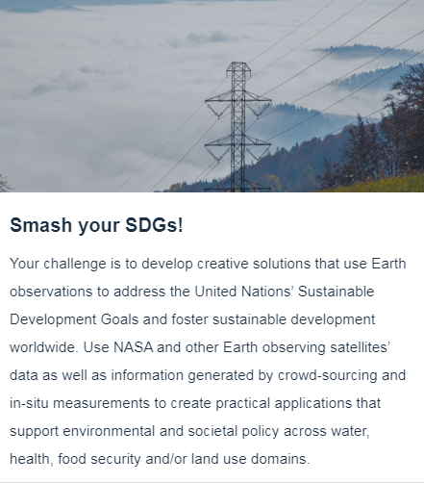

Our Challenge

Slide 3
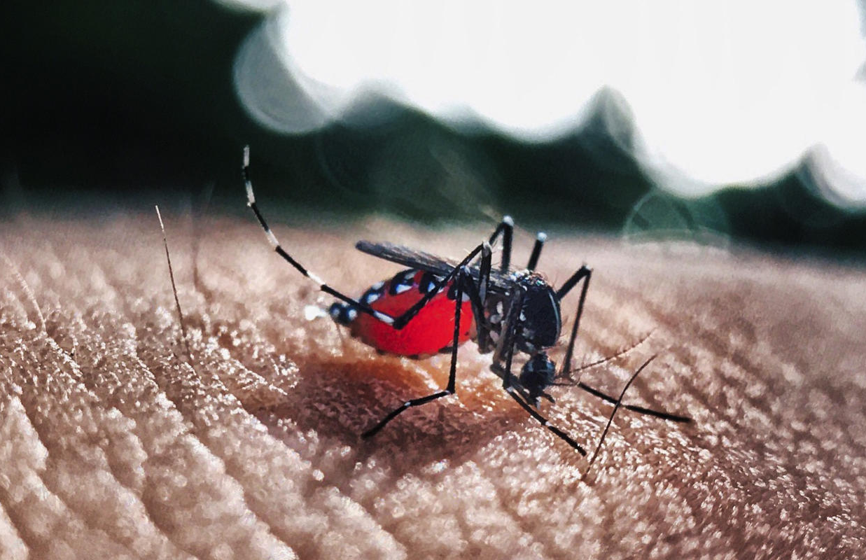
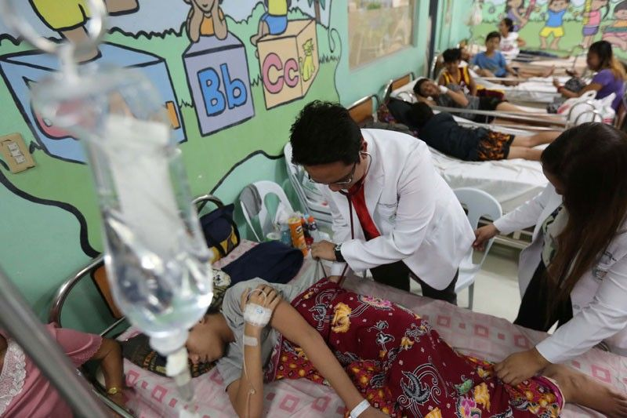
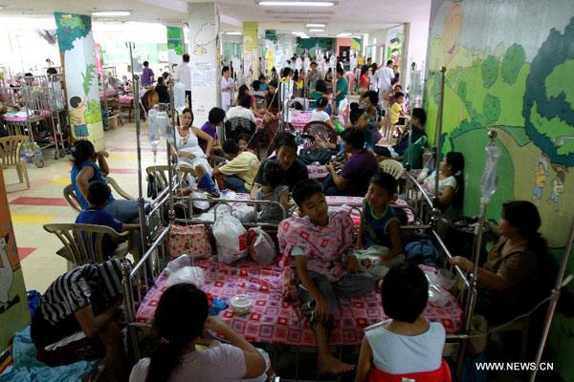
The Problem
Dengue cases are at an epidemic level in the Philippines with 1,107 deaths and more than 271,000 cases reported. Data on dengue takes time to be manually gathered which hampers the health sector’s ability to deal with the threat.

Slide 4
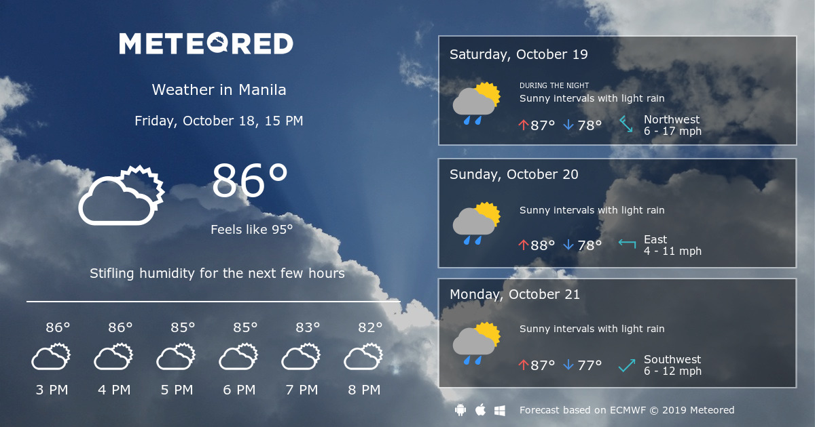
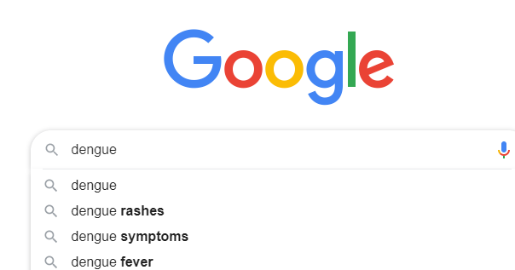
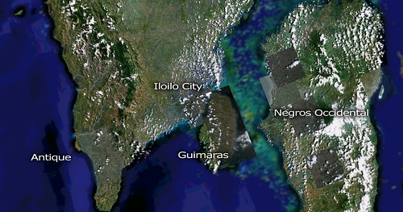
Solution: Advanced Dengue Prediction
Correlate dengue cases and deaths with real-time data from climate, google searches, and satellite maps, giving an advance indicator of when dengue will emerge and potential dengue hotspot locations.

Slide 5
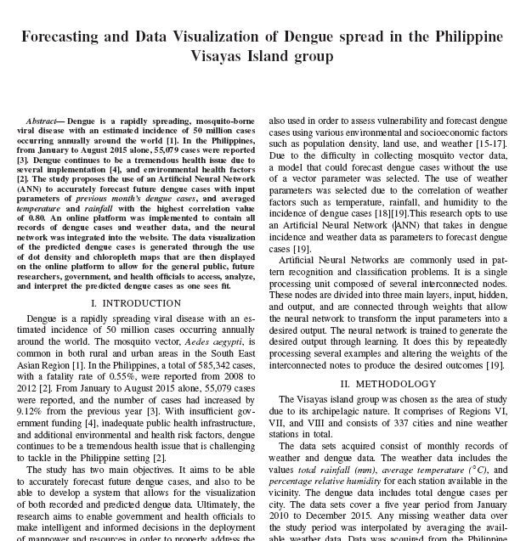
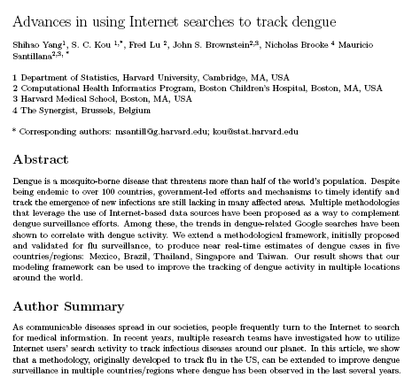
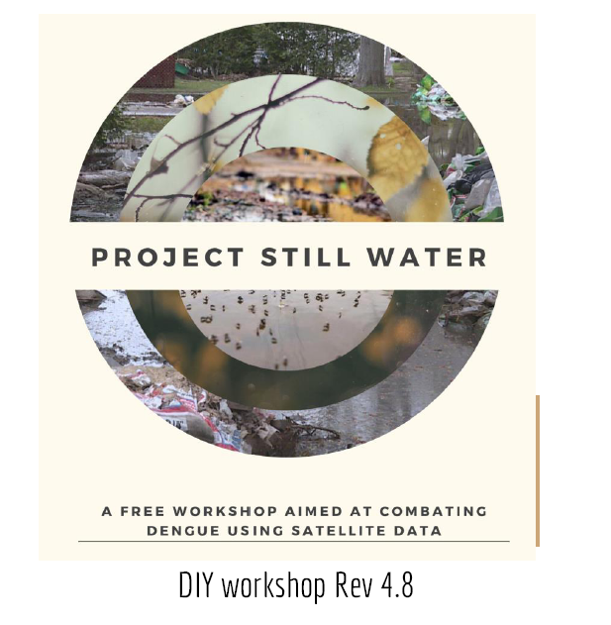
Related Literature
Caro, et. al. 2016
Yang, et. al. 2016
Chua et. al. 2018

Slide 6
Correlating Dengue Cases and Deaths
Training Period
R2 = 85%
Testing Period
R2 = 69%

Slide 7
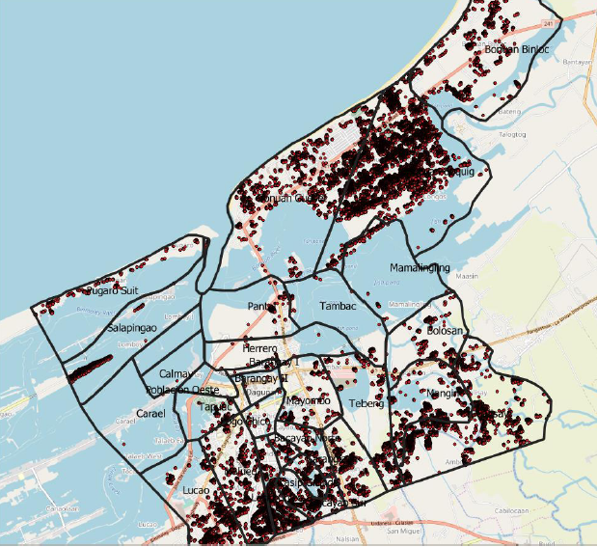
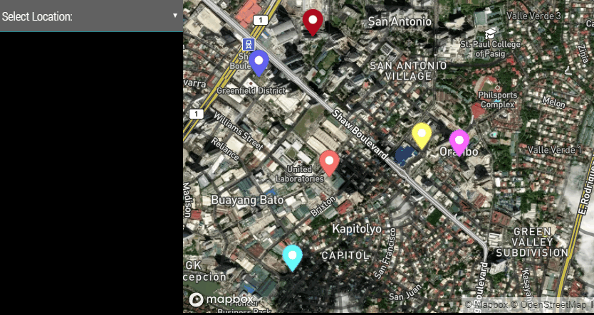
Finding Mosquito Hotpots From Satellite Images

Slide 8
AEDES Dashboard

Slide 9
Next Steps
Complete time-series training for all regions
Add satellite data for all target regions
Recommend target areas for on the ground dengue case and deaths monitoring
Set future thresholds for dengue epidemics and short list areas that will be hit first

Slide 10
Save Data. Save Lives.

